Slide 1
Final Group Project (DAB 201)
BY GROUP 5

Slide 2
TEAM MEMBERS
MANPREET (0800080)
HARBIR SINGH SAHI (0797037)
PRATVA (0766531)
RAVI (0795606)

Slide 3
ABOUT DATASET
The data set contains information of video games which are having sales greater than 100,000 copies along with critic and user ratings.
The dataset includes games released since the year 1976 till 2016.
It contains global sales record along with sales in North America, European Union, Japan and rest of the world.
The dataset includes details of Genre of the game, Publisher/Developer of the game and Platforms where the game is played.
DATA SOURCE : https://www.kaggle.com/datasets/kendallgillies/video-game-sales-and-ratings

Slide 4
ABOUT DATASET
We are using the virtual gaming dataset for our project. We have performed an extensive data analysis on the dataset by creating visualizations using the sales of different gaming platforms across the North American continent, Japan and Europe.
We focused on visualizing the sales of different gaming platforms in these three regions, where we categorized them using the genre.
This project focuses on the best-selling games and the profits they have made around the globe. Also, we have compared the sales of the most popular games in North America to their global sales.

Slide 5
CHALLENGES AND ISSUES RESOLVED
Most of the challenges we faced for this project were during the Data Cleaning phase. The data we used was not cleaned up to our expectations.
We changed the data type of the “years released” column to the date format from the text format.
Also, we have changed the “JP sales, Global sales, EU sales and other sales” data from text to decimal numbers.
The next challenge we faced was we found many missing values in the data set. We removed the “user count, rating, user score, critic score and critic count” columns to correct this issue.
There was incomplete data for the year 2017. We also removed that year from our analysis.
For comparison purposes, we also created another column, “Rest of the world” where we have calculated the sales in all other regions except North America.

Slide 6
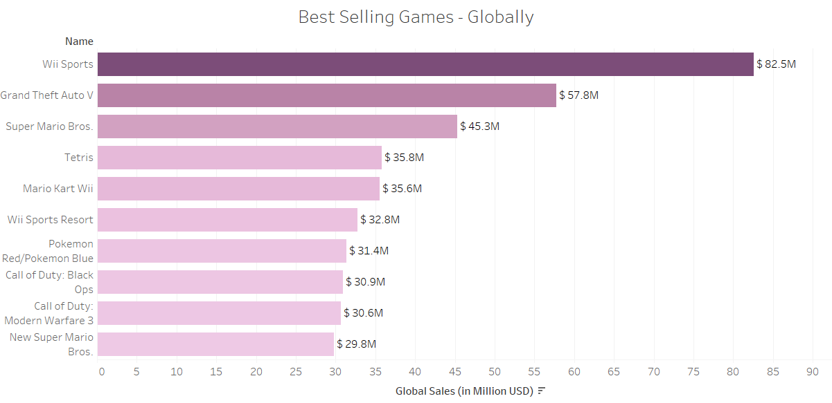
Top 10 highest selling games globally
From the Bar graph, it can be seen that ‘Wii Sports’ is the top selling game all over the world with $82.5 million sales with ‘Grand Theft Auto V’ coming at 2nd place.

Slide 7
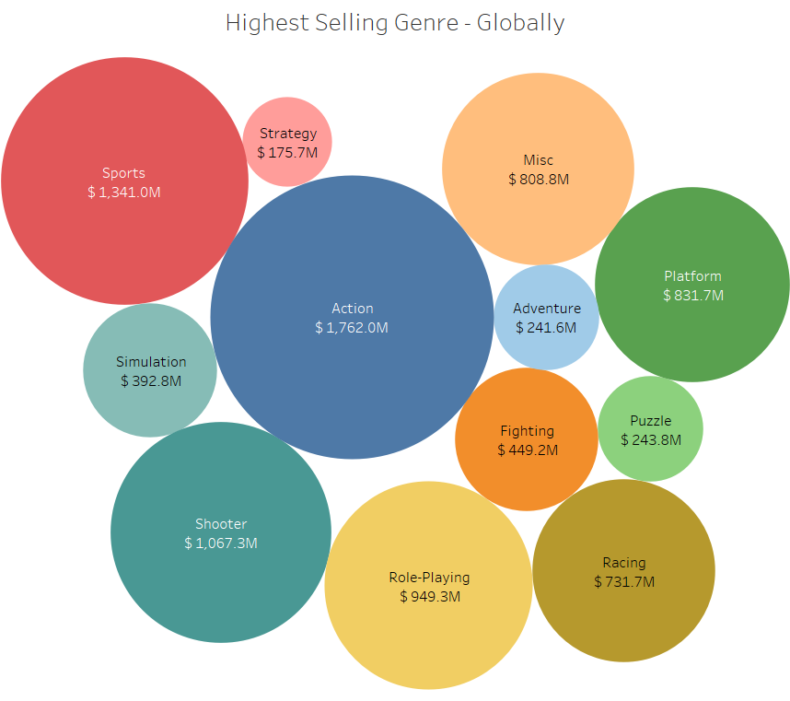
Most played game genres
From the Bubble chart, it is evident that ‘Action’ games are the most played games amounting to $1,762 million dollars till 2017.

Slide 8
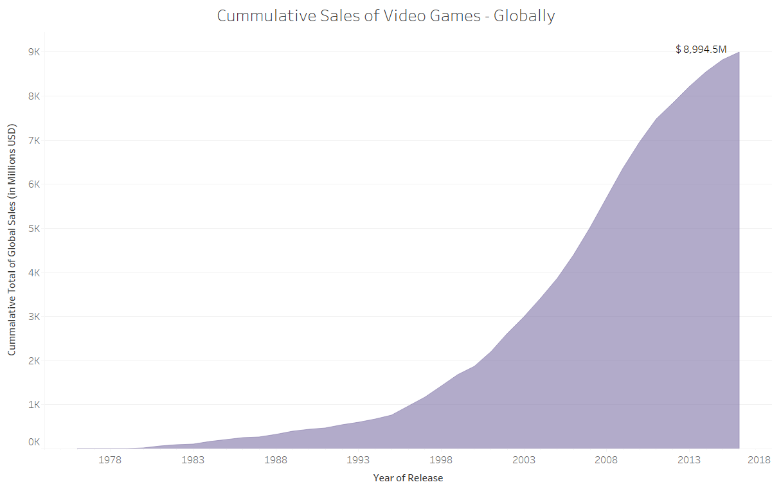
Total Sales of Video Games till year 2017
From the above graph, it is clear that the total global sales of video games amount to about $8,994 million dollars.

Slide 9
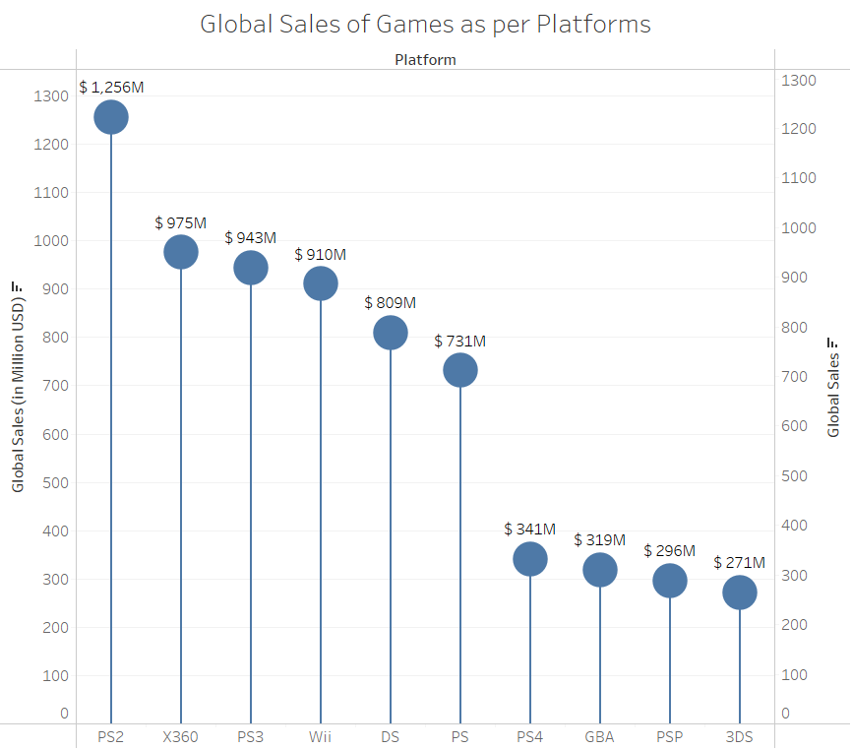
Top Platforms according to their sales of their games
Games which are played on PS2 platform have garnered the maximum number of sales at $1,256 million.
We can see that PS2 has quite a lead over rest of the platforms with x360 and PS3 coming at 2nd and 3rd position with $975 and $943 million respectively.

Slide 10
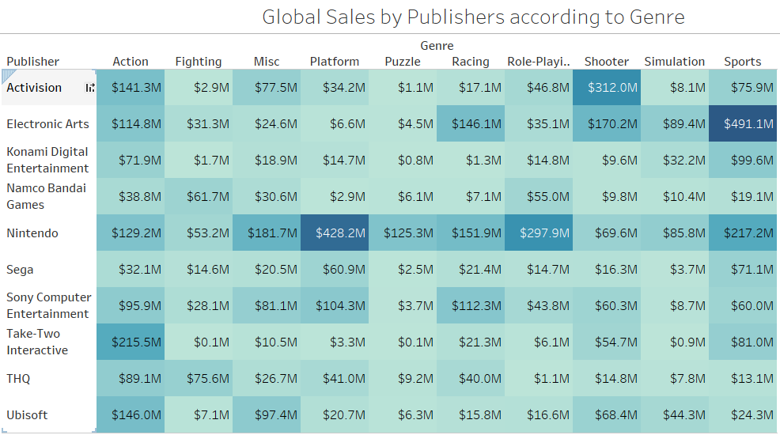
Global Sales according to Publishers and Genre of the game
From the table, it is evident that ‘Nintendo’ had the most sales in ‘Platform’ and ‘Role-Playing’ genres with $428.2 and $297.9 million earnings respectively.
While ‘Electronic Arts’ has earned most in the genre ‘Sports’ at $491.1 million.

Slide 11
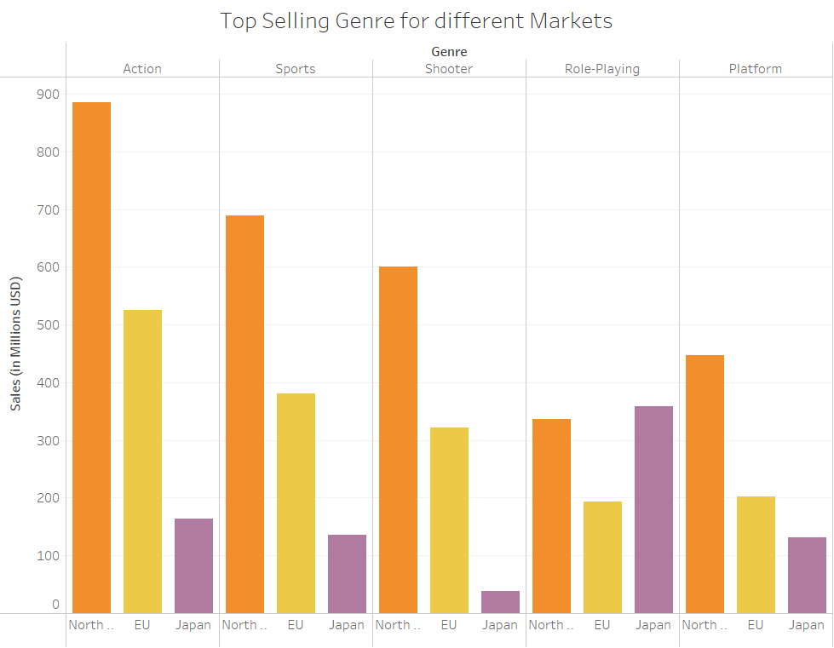
Top Selling Genres for North America and Others
The graph provides us insight that, ‘Action’ is the most sold video game genre with sale of around $890 millions.

Slide 12
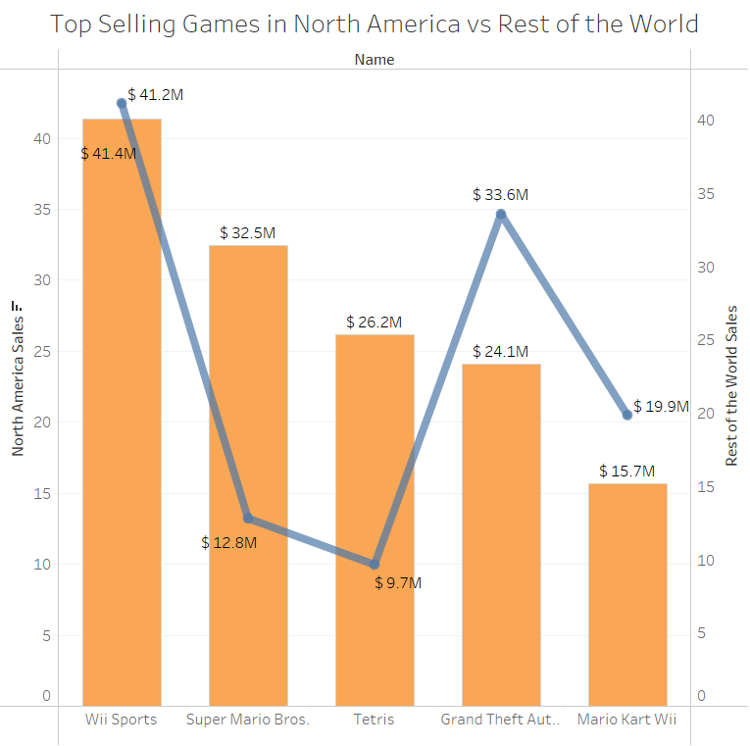
Top Selling Video Game in North America vs Rest of the World
‘Wii Sports’ is the best selling game in North America as well as in rest of the world with sale of around $41 million for both regions.

Slide 13
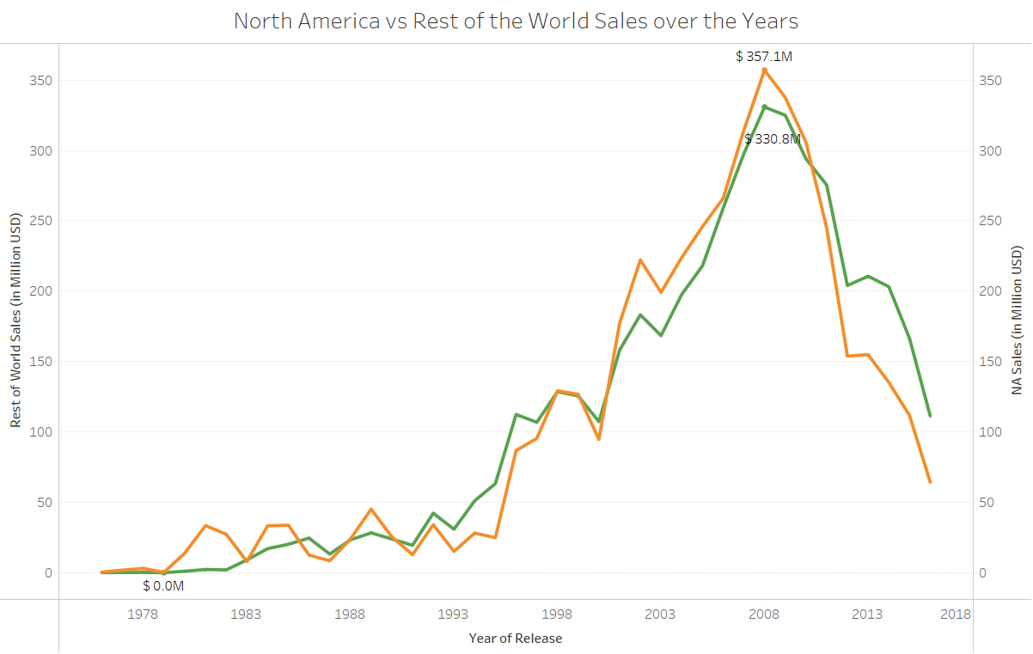
Video Game Sales over the years in North America and Rest of the World
From the graph, it can be concluded that maximum number of sales happened in the year 2008.
$357.1 million sale in North America and $330.8 million sale in rest of the world.

Slide 14
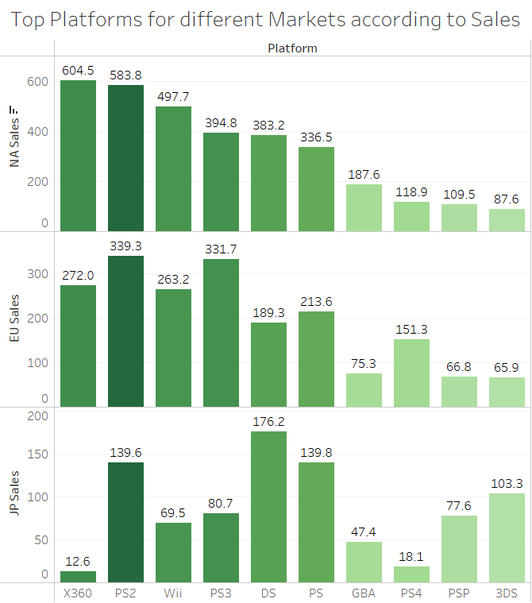
Top Platforms for different regions as per sales
We can see that X360 has the most sold games in North America till 2017 with $604.5 million sales.

Slide 15
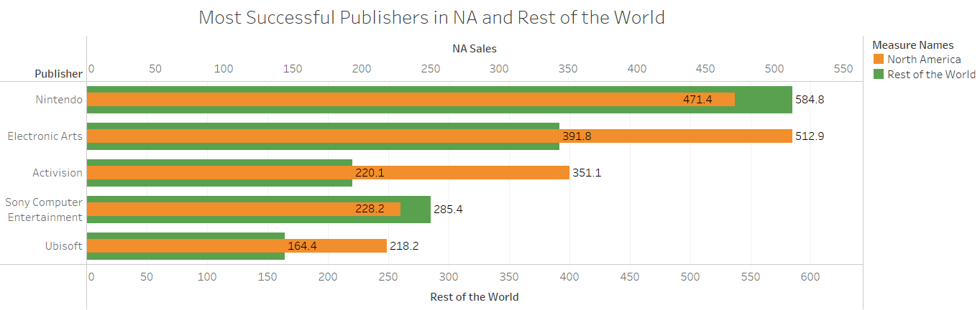
Most Successful Publishers in NA and Rest of the World
‘Nintendo’ has the maximum number of sales for the world except NA with $584.8 million sales.
While ‘Electronic Arts’ is the best selling publisher in North America with $512.9 million sale.

Slide 16
CONCLUSION
Through our analysis and insights from the project showed that North America has the highest number of Video game sales compared to other regions. Using the visualizations, companies could infer which genre is popular among the public, and they could use these visualizations to produce more video games for the most popular genre.

Slide 17
RESEARCH QUESTION: You are working for a company, and your IT director assigns you to do research and provide Analytics and BI Platforms for your company. How will you Choose a Platform? Review and compare five platforms.
BI platforms support company’s BI strategy by making it easier to access and analyze your data. from company’s point of view, we will choose that BI platform that will create the stunning data visualizations within minutes, allows to customize dashboards and which platform helps us to improve processes.

Slide 18
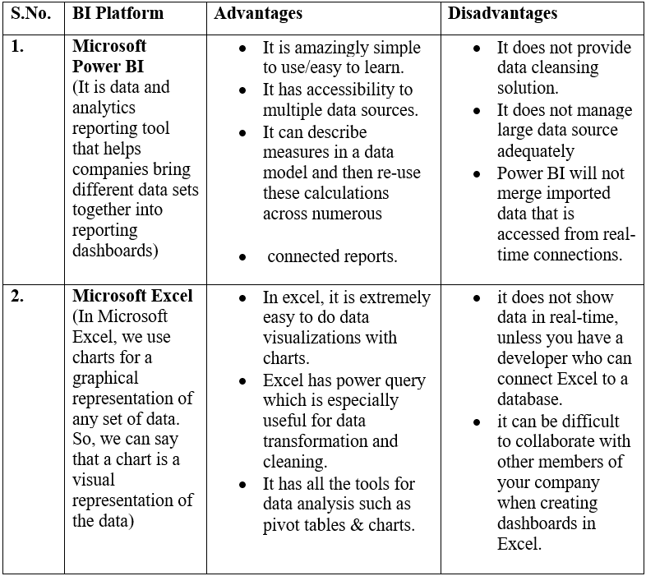

Slide 19
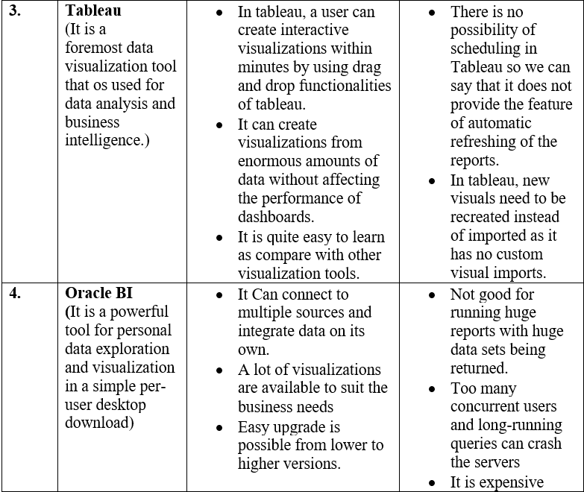

Slide 20
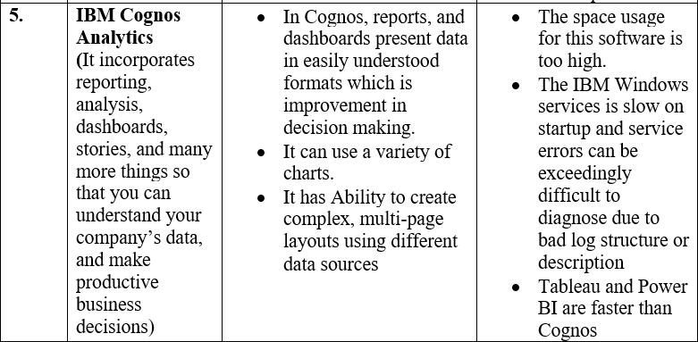

Slide 21
Finally
No doubt, many BI platforms have their benefit, but for this project, we chose tableau as it specializes in quick and interactive visualizations compared with other tools. It allows you to create visualizations within significantly less time, and you have to do drag and drop functionalities. In tableau, some data views are displayed in a table on every sheet. As we know, a table is a combination of rows and columns consisting of different components: headers, axis, panes, cells, and marks. Moreover, we can choose to show or hide titles, captions, field labels and legends. Tableau can also use other scripting languages with a meagre cost with excellent mobile support. So, for better visualizations and to save time, we will use tableau for this project.

